Slide 1




Tanzania Geothermal
Development Company Limited
Unveiling Geothermal Treasure in Tanzania
National Renewable Energy Week
Shakiru Idrissa Kajugus
Director Business Development
May, 2025

Slide 2

Tanzania Geothermal
Development Company Limited
Outline
1
TGDC in brief
Strategy
Geothermal Resources
Flagship Projects
Geothermal Uses
Opportunities
2
3
4
5
6
Notes:
Yaliyomo kwa ufupi

Slide 3
Tanzania Geothermal
Development Company Limited
TGDC in Brief
ESTABLISHMENT
OWERSHIP
Incorporated 2013
Operational 2014
100% owned by TANESCO
(Subsidiary Company)
TGDC
MANDATE
FUNCTIONS
To spearhead the country’s geothermal Development.
Explore, Develop, and Utilize geothermal for Power and Direct Uses.

Slide 4
Tanzania Geothermal
Development Company Limited
Strategy
Strategic Goals
Strong Organizational Capabilities & Governance
Strategic Plan (2017 -2042)
Research, Innovation & Development
Enabling Business Environment
Financial Sustainability

Slide 5
Tanzania Geothermal
Development Company Limited
Strategy
Mission
Vision
Target
“Offer reliable and efficient geothermal energy development services”
“Be the most competitive regional geothermal development company”
Generate 130MW by 2030

Slide 6
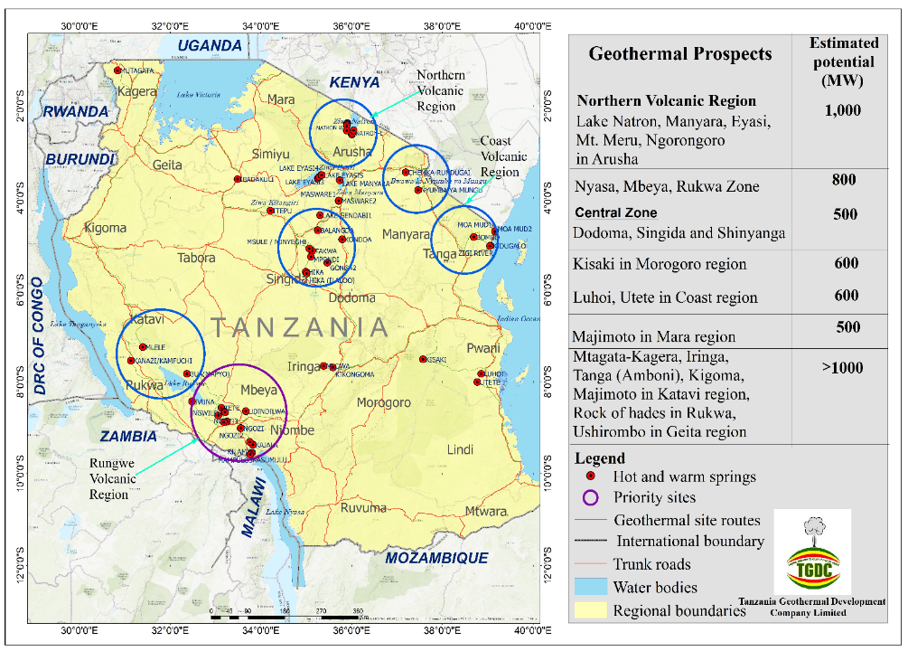
Tanzania Geothermal
Development Company Limited
Geothermal Resources
Potential
5000MW –Electricity
15000MWt - Heat

Slide 7
Tanzania Geothermal
Development Company Limited
Geothermal Resource…
Electricity (≥75°C)
Direct Heat Uses (≥20°C)
Geothermal Development Stages
1
2
3
4
5
Development Stages
Preliminary Survey
Explorations
Resource Confirmation
Development & Production Drilling
Operations & Utilization

Slide 8
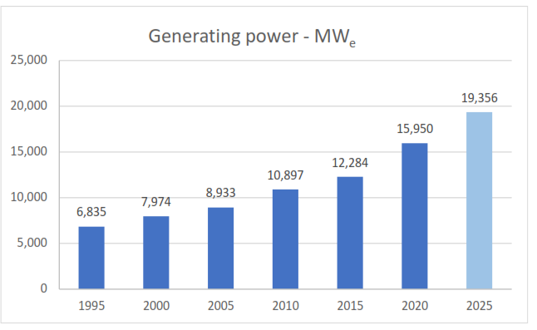
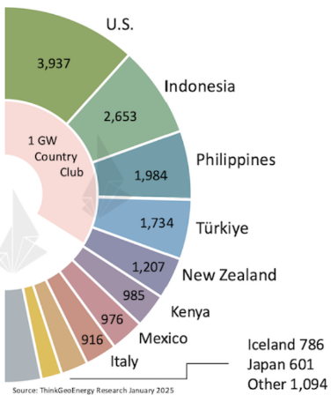
Tanzania Geothermal
Development Company Limited
Geothermal Resources…
Geothermal generation trend
Total installed capacity as of 2025 is 16.87GW.
Kenya’s Installed capacity is 985MW (No.1 in Africa and No.6 Globally).
88 countries use geothermal resources worldwide for power and direct uses.
29 countries generate geothermal power.

Slide 9
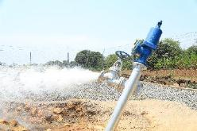
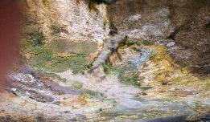
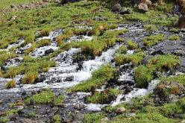
Tanzania Geothermal
Development Company Limited
Flagship
Projects
1
NGOZI- 70MW
Mbeya
200MW
KIEJO-MBAKA-60MW
Mbeya
2
3
SONGWE-5MW
Songwe
4
LUHOI-5MW
Coastal
5
NATRON-60MW
Arusha

Slide 10
Status of Flagship Projects
Ngozi
Kiejo-Mbaka
Songwe
Luhoi
Natron
Geo-scientific explorations completed
Exploration on Progress
Resource: High temp. (232 ± 13°C).
Components:
Steam Field, Power Plant, T/Line.
Cost: $336million.
Financing: Public/ PPP/IPP.
Status: Resource confirmation.
Drilling rig - 
Consultancy - 
Contractor-
Infrastructure - 
Consumables - 
Permits - 
Resource: High temp. (>140°C).
Components:
Steam Field, Power Plant, T/Line.
Cost: $288million.
Financing: Public/ PPP/IPP.
Status: Resource confirmation.
Consultancy - ongoing
Permits - 
Fund mob. – ongoing.
Resource: Medium temp. (112 ± 16⁰C).
Components:
Steam Field, Power Plant, T/Line & direct uses.
Cost: $32million.
Financing: Public/ PPP/IPP.
Status: Resource confirmation, fund mobilization.
Permits: EIA, PLs, land obtained.
Resource: Medium temp. (95 - 145⁰C).
Components:
Steam Field, Power Plant, T/Line & direct uses.
Cost: $32million.
Financing: Public/ PPP/IPP.
Status: Resource confirmation, fund mobilization.
Permits: EIA, PLs, land obtained.
Cost: $228 million.
Financing: Public/ PPP/IPP.
Resource: High temp. system
Components:
Steam Field, Power Plant, T/Line & direct uses.
Status: Detailed exploration
Permits: ESIA, PLs.
Status

Slide 11
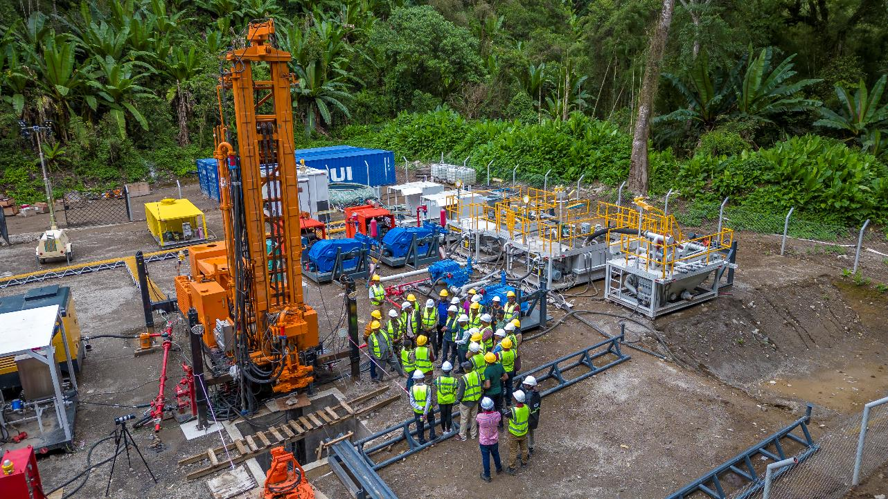
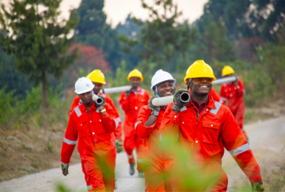

Slide 12
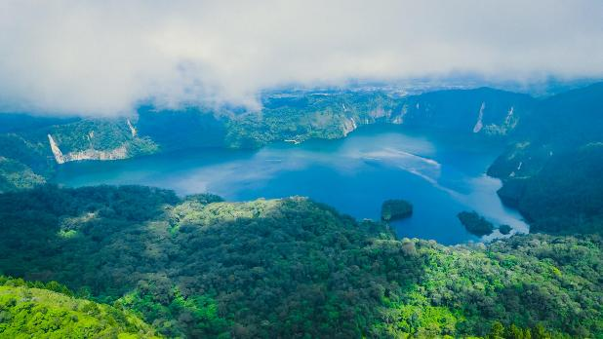
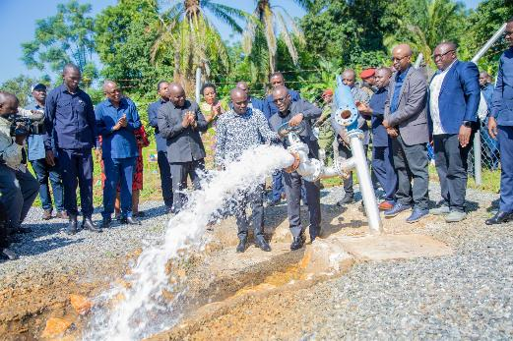
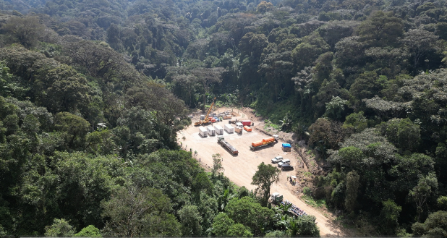
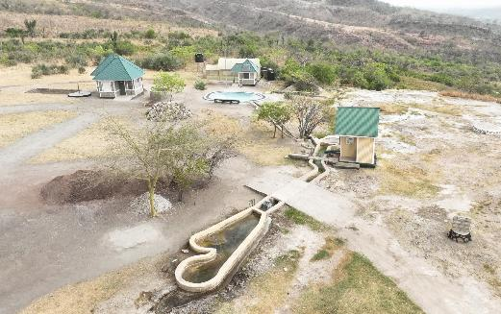

Slide 13
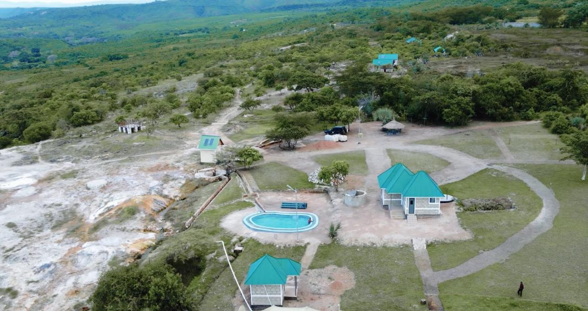
Songwe Prospect
Located in Songwe Region, southwestern Tanzania.
East African Rift System (EARS).
Low to medium-temperature geothermal system (>86°C on surface).

Slide 14
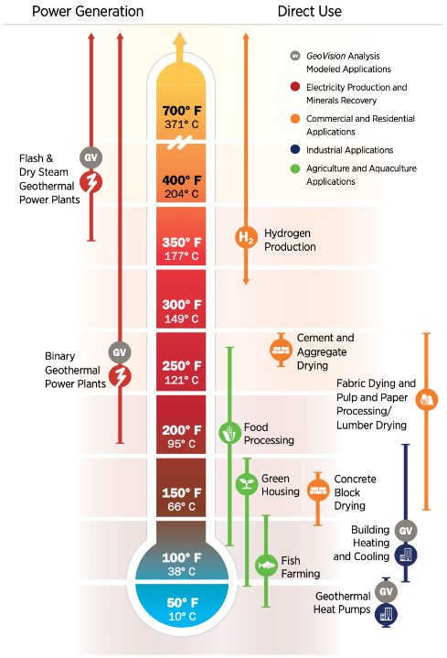
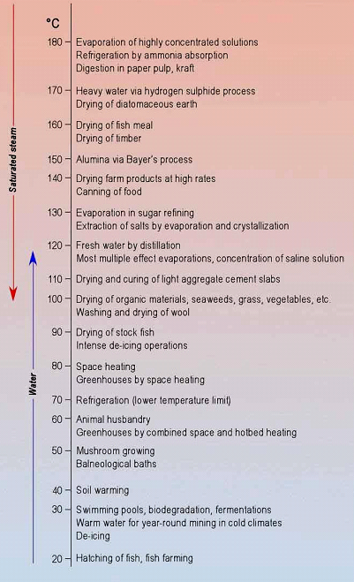
Geothermal Uses

Slide 15
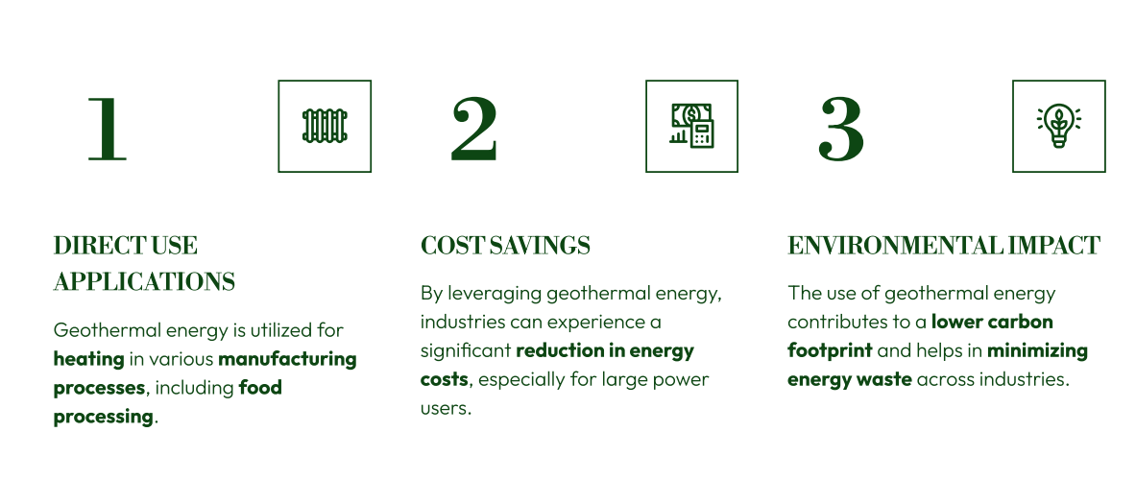
Opportunities
Energy Efficiency
Industrial
Large Building

Slide 16
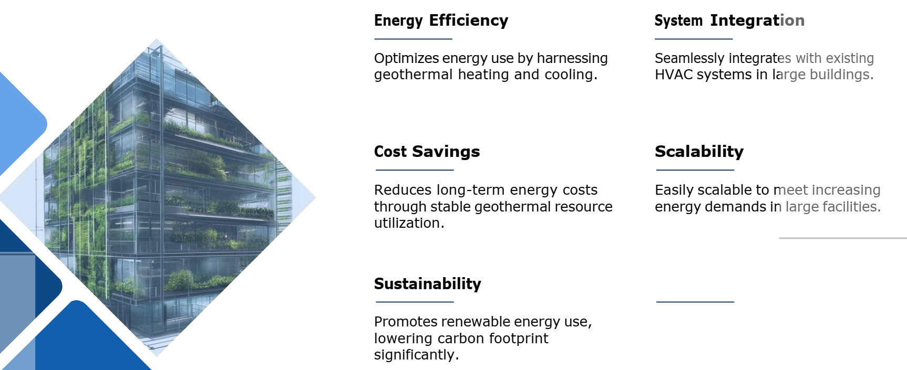
Opportunities
Energy Efficiency
Industrial
Large Building

Slide 17
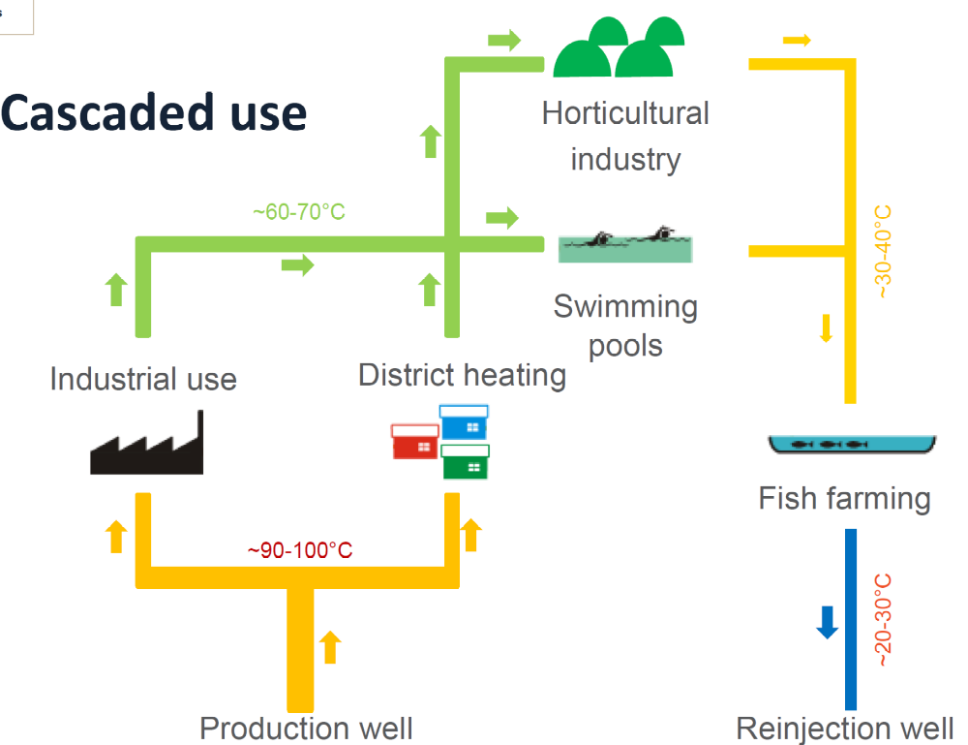
Opportunities
Energy efficiency;
Industrial
Large power Uses

Slide 18
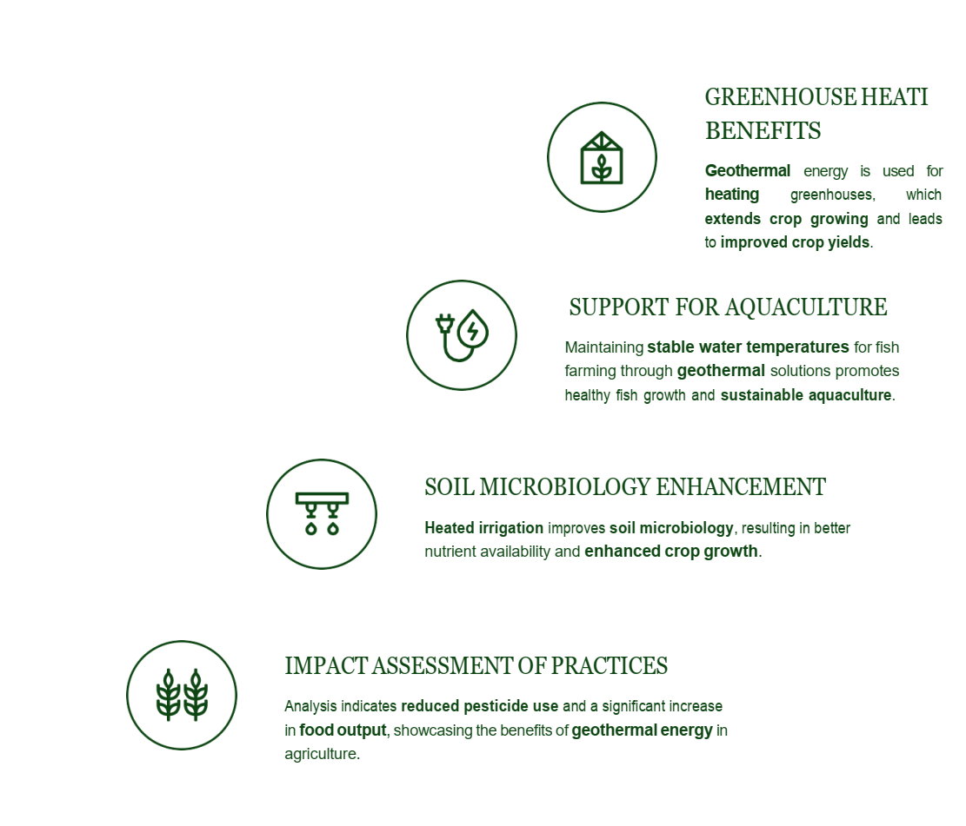
Opportunities
Agriculture
&
Food Processing

Slide 19
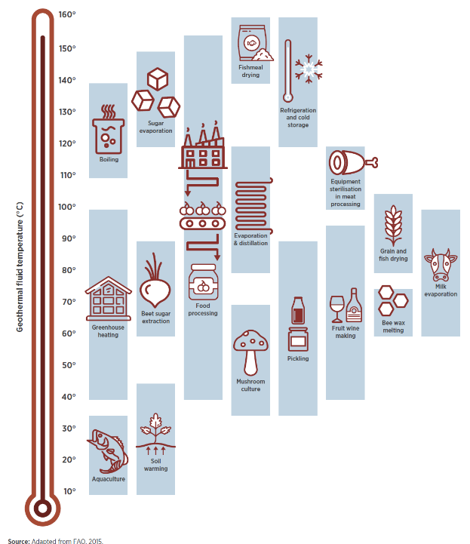
Opportunities
Agriculture
&
Food Processing

Slide 20
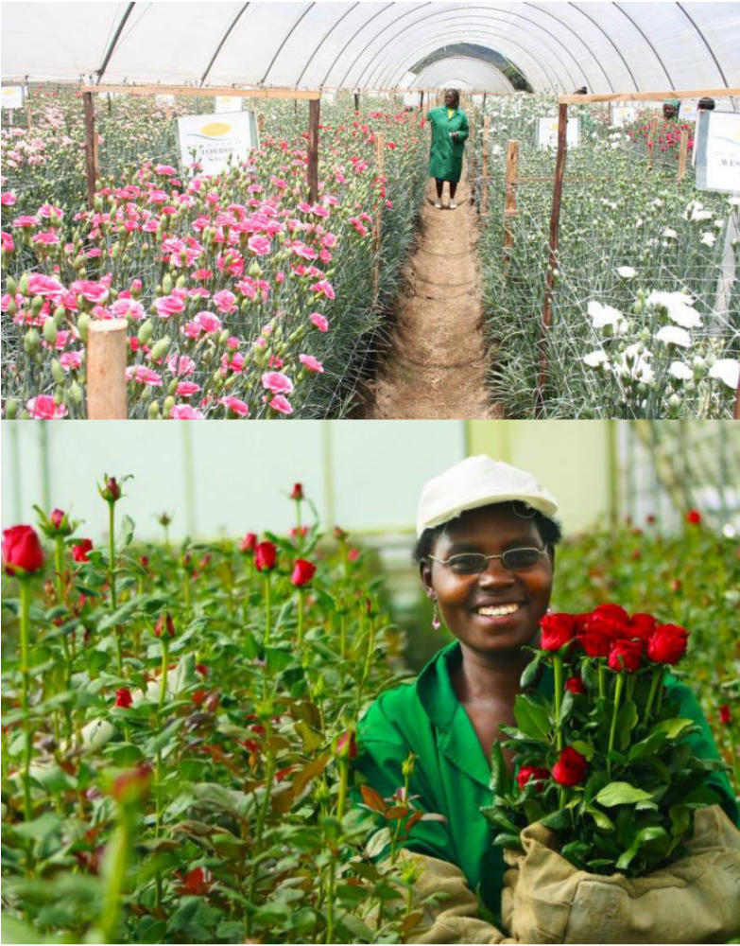
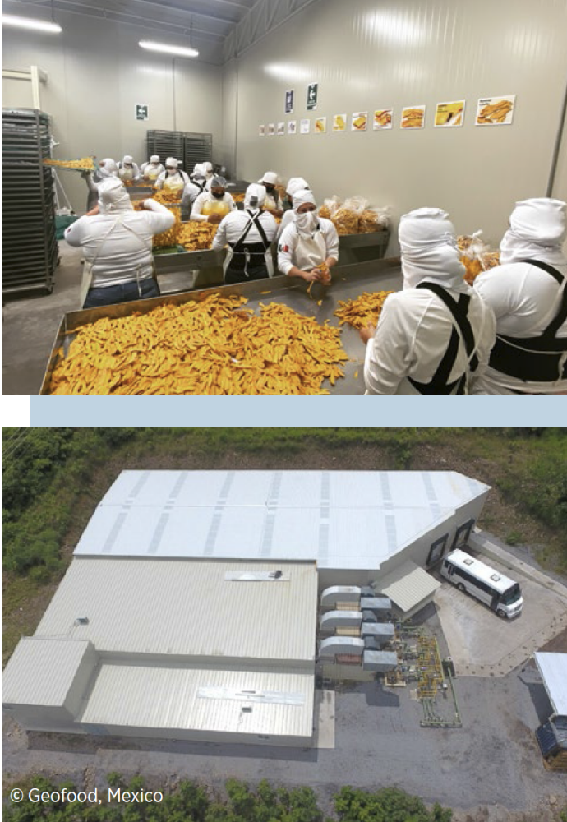
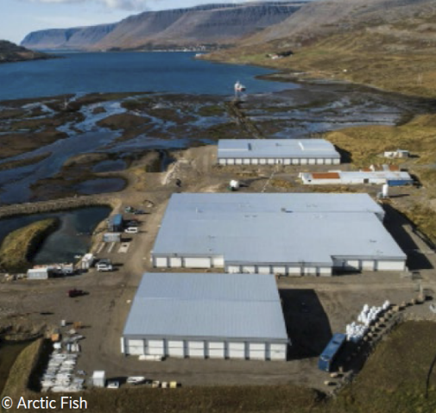
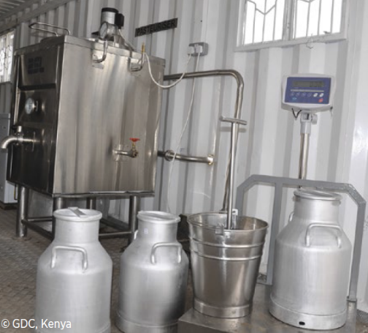
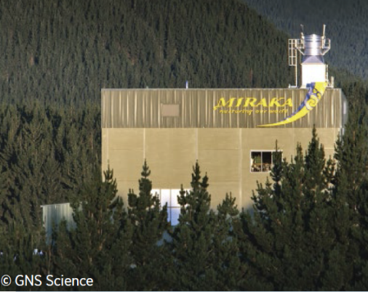
Opportunities

Slide 21

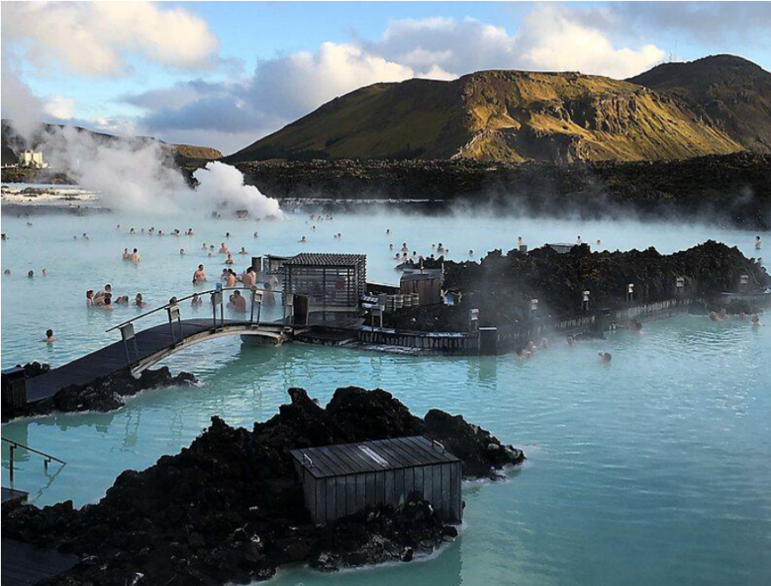
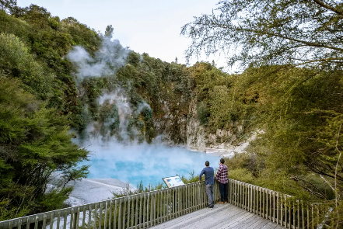
Opportunities
Tourism

Slide 22
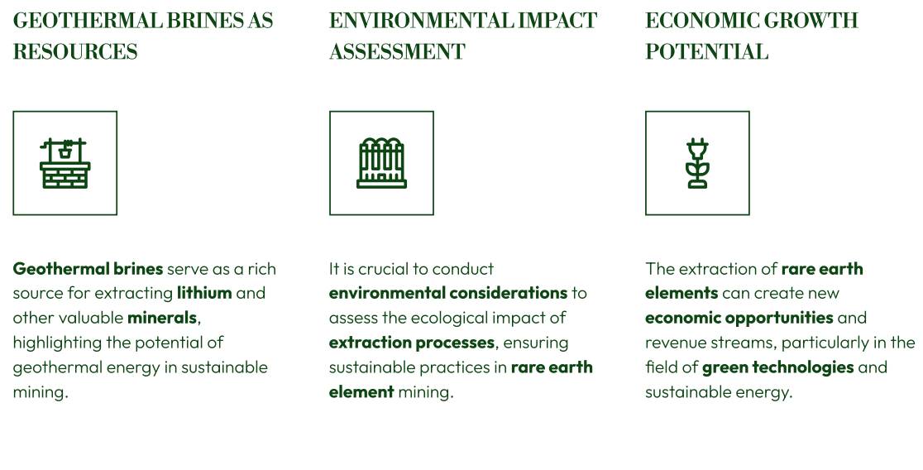
Opportunities
Extraction of Rare Earth Element & Gas

Slide 23
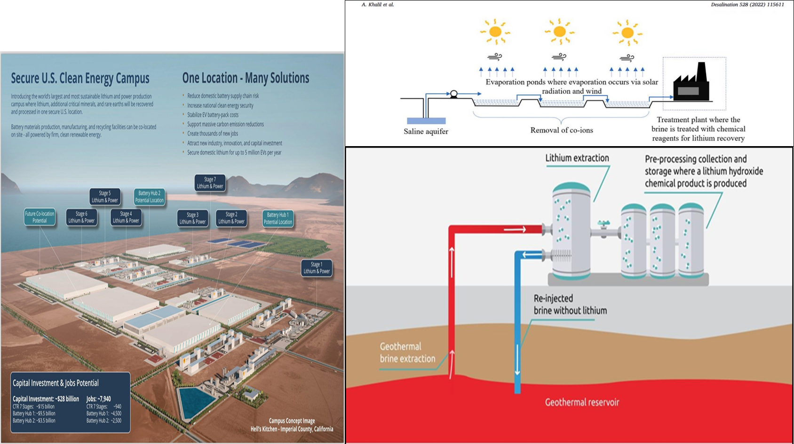
Opportunities
Extraction Processes

Slide 24
Tanzania Geothermal
Development Company Limited
Hitech products, batteries
Industrial
Boric acid
Lithium, Li
Industrial, agriculture
CO₂
Applications of REE
Photoelectic cells
Battery
Caesium, CS
Lanthanum, La
Neodymium, Nd
Strontium, Sr
Magnets
Fireworks

Slide 25



Slide 26


